Slide 1
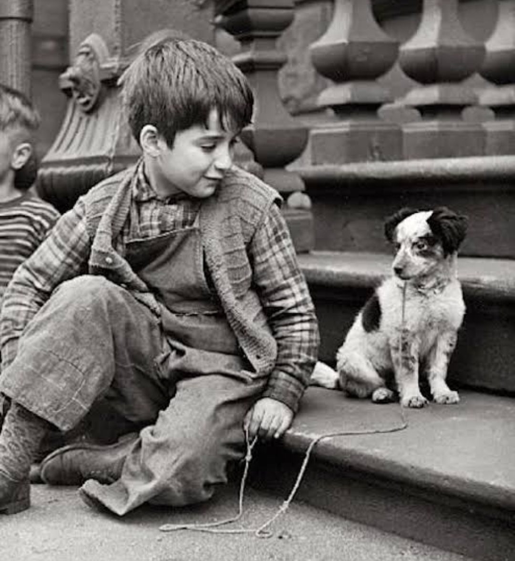
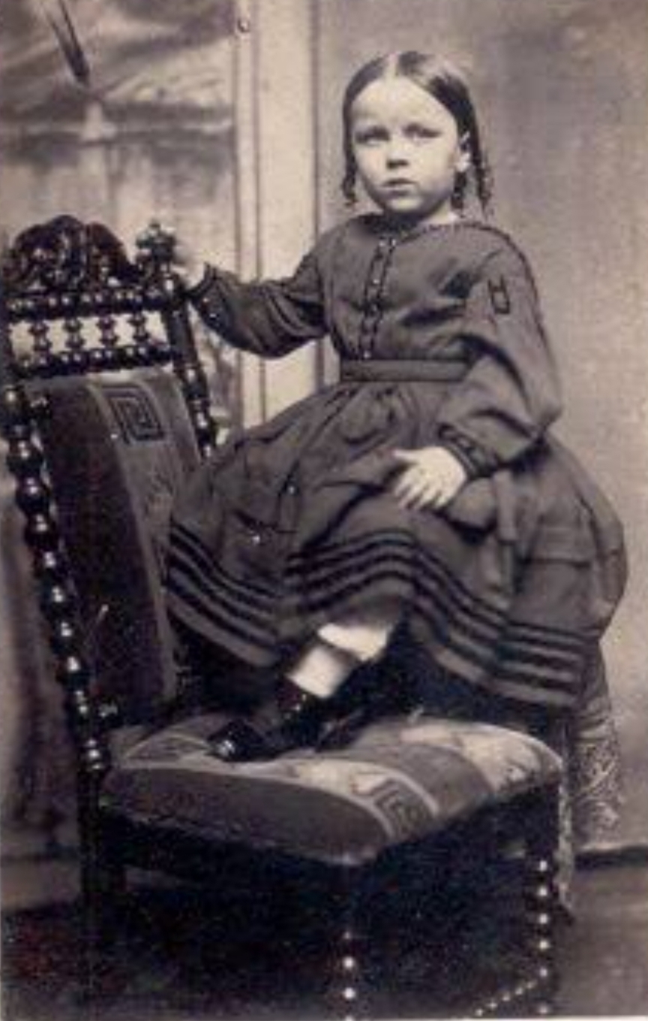
EXPLO PRESENTATION
Problem statement :
We often come close to some photos that belong to our grandparents and as they are black and white we always wonder what were the actual colours, so to overcome this problem we will create a deep learning model that works along with Gan’s to colorize black and white photos.
It’s not the first time someone is trying to solve this problem it has been tried multiple time using different methods like using regression models along with convo nets but applying Gan’s is still the most efficient way.

Slide 2
solution
One of the most exciting applications of deep learning is colorizing black and white images. This task needed a lot of human input and hardcoding several years ago but now the whole process can be done end-to-end with the power of AI and deep learning. You might think that you need huge amount of data or long training times to train your model from scratch for this task but in the last few weeks we worked on this and tried many different model architectures, loss functions, training strategies, etc. and finally developed an efficient strategy to train such a model, using the latest advances in deep learning, on a rather small dataset and with really short training times.
The model is known as Generative adversarial network(GAN’s) which uses a L1 loss function which is also known as Least Absolute Deviations along with Adversarial Loss which helps to solve the problem in an unsupervised manner.

Slide 3
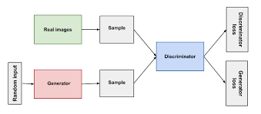
How does Gan’s work
First we provide an input image to our model then the image is passed through generator model then it is compared with sample image then both of them are passed through discriminator model to identify which one is fake and which one is real.

Slide 4
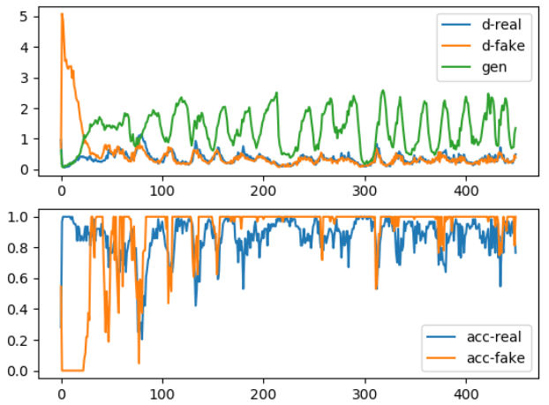
Loss function we optimize
In the upper column the green line shows the loss for generated output the orange and the blue line represent losses for fake image and real output.
our combined loss function is composed of two losses the first one is the adversarial loss and the second one is the L1 loss.
So our combined loss function is:
where λ is a coefficient to balance the contribution of the two losses to the final loss (of course the discriminator loss does not involve the L1 loss).

Slide 5
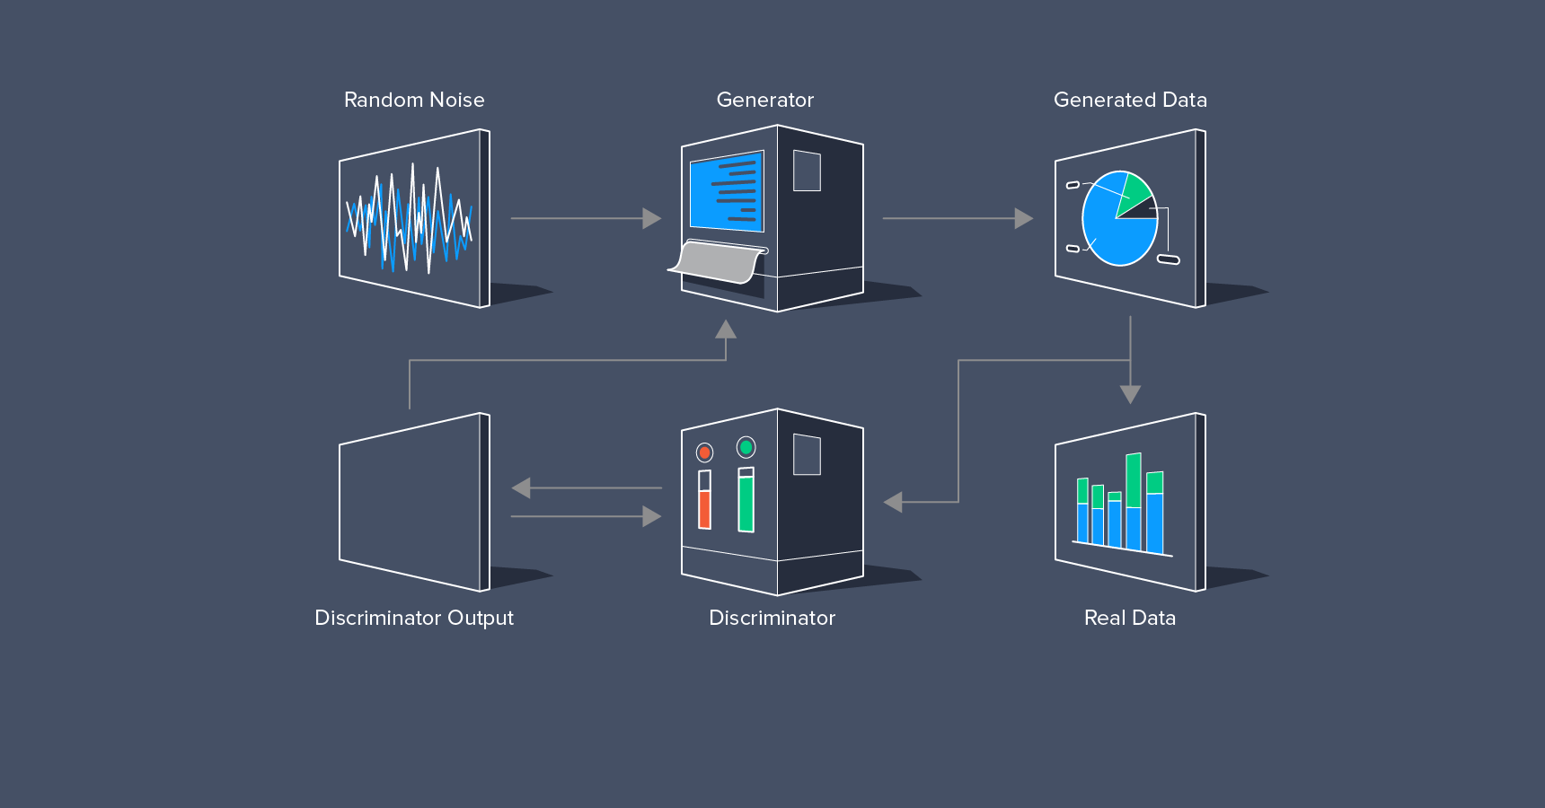
Method to create our model
In this diagram the random noise depicts the input and the discriminator output depicts the final output.
We will create our model in three steps:
Creating a baseline network or it is also called the generator .
Creating a convolutional Gan layer or it is also called the discriminator.
Training the model

Slide 6
We can see number of channels are down-sampled here
Baseline Network
Here the number of channels are being up-sampled
We can see that firstly the input image is down-sampled using stride of 1 using a 4-4 convo net then the image is again up-sampled to get the output image to be passed to discriminator which consist of 3 channels. We will use relu activation function.

Slide 7
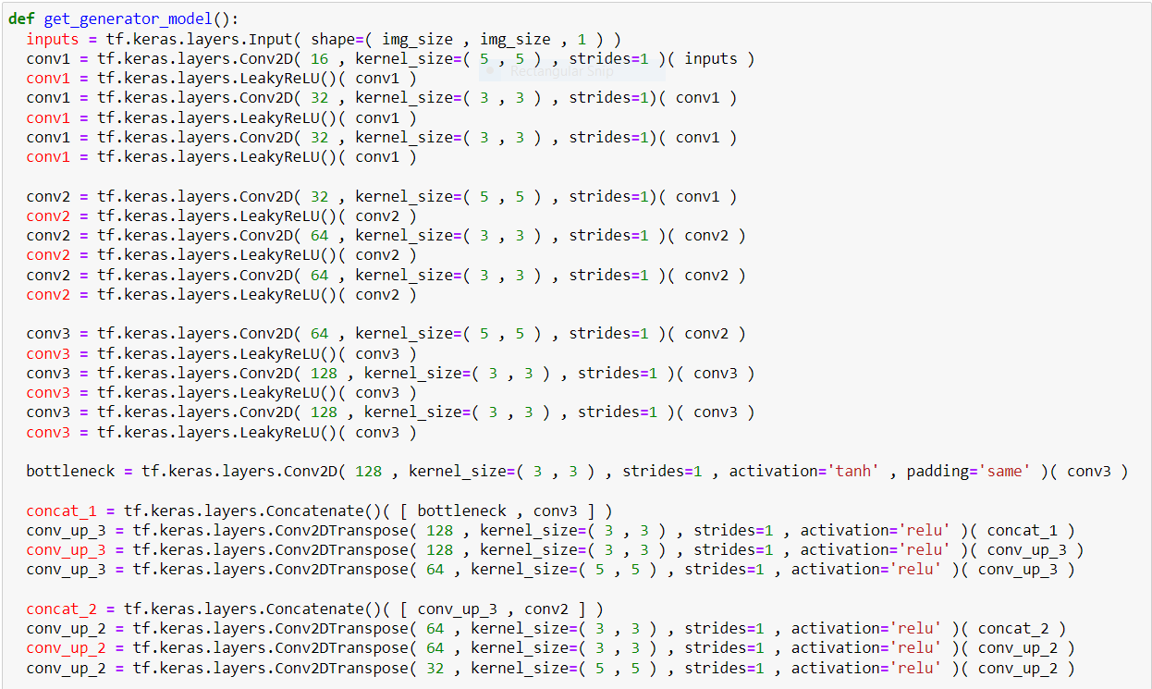
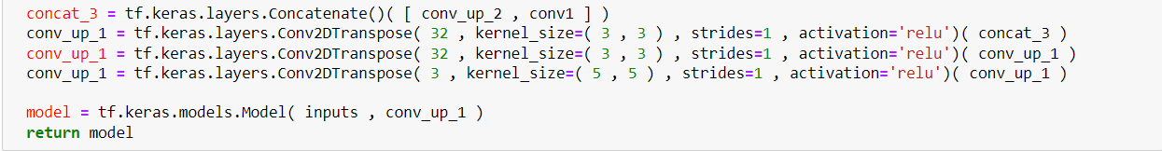
This is our baseline network:
This part shows upsampling
This shows down-sampling

Slide 8
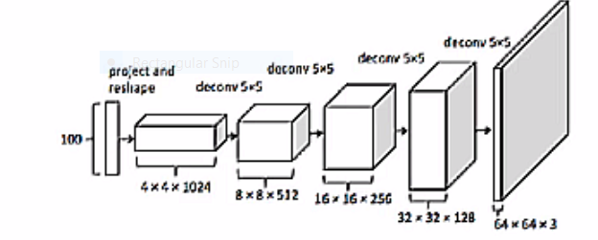
Convolutional GAN
The number of input channels is 4 here
But the number of output channels is 64 here which specifies that the channels are doubled everytime.
Now in the discriminator part the number of input channels are doubled in each down-sampling .
We use Relu activation function in this model and at the end we use sigmoid function which discriminates the real and fake image.

Slide 9
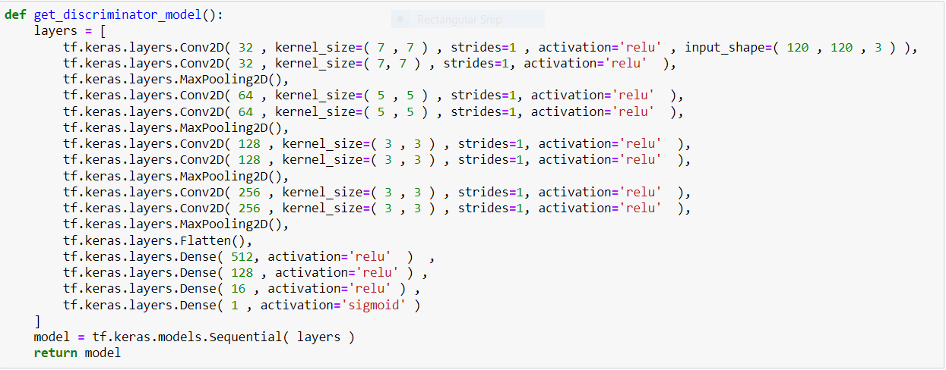
Creating the convo Gan layer:
We can see the number of channels being doubled here

Slide 10
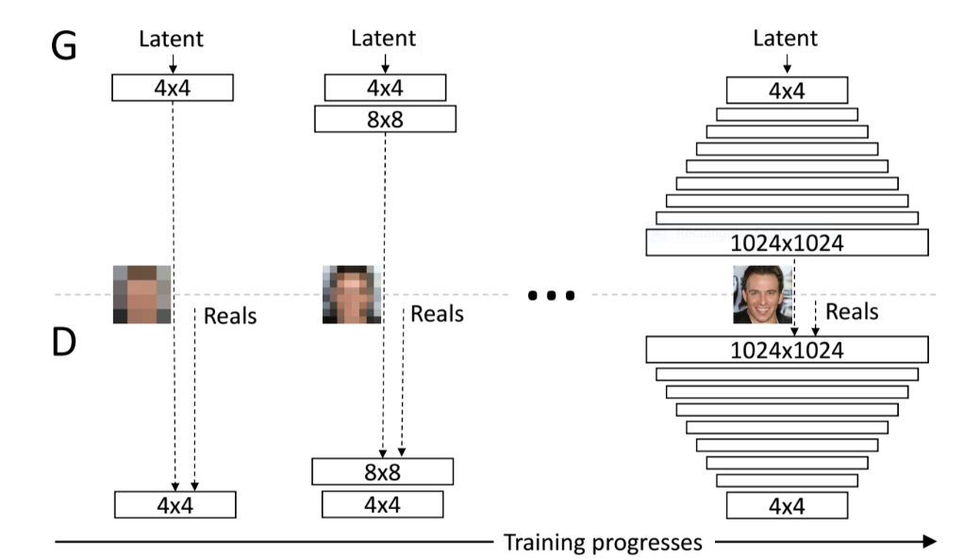
Training The Model
For a model with CIFAR-10 dataset which is a dataset much larger than our dataset it takes around 43 hours to train the model for 400 epochs with around 128 features . So to train the same model using dcgaan model for 100 epochs will take about 2.5 hours .
Now we train our model on 100 epochs and 512 features but we use a relatively small dataset.
So it takes out model about 5009 seconds(or we can say 1:23:29 hours) to train the model.
Generator
Now we can see as we progress through different epochs the image quality gets better
discriminator

Slide 11
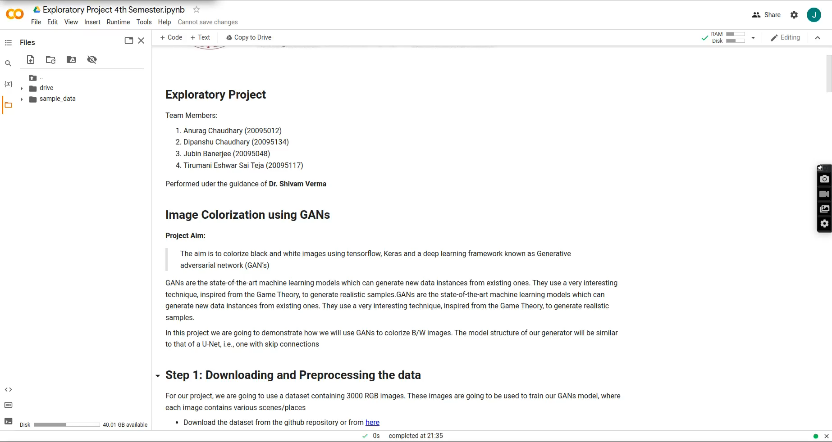
Training video

Slide 12
Results
The result is shown in three columns, in the first column we have gray scale image then in the second column we have generated output using the model the in the third column we have original image.

Slide 13
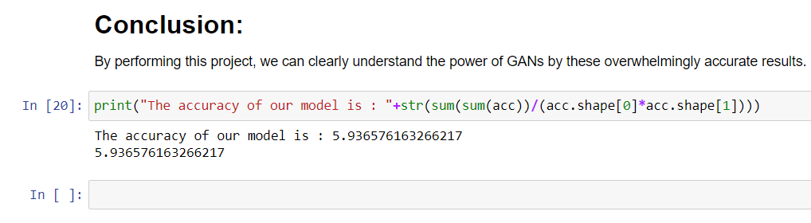
Mis-colorization was a frequent occurrence with images containing high levels of textured details. This leads us to believe that the model has identified these regions as grass since many images in the training set contained leaves or grass in an open field.
Overall the results look promising and the accuracy of our model looks really good .
The accuracy of our model is predicted using Manhattan score which should be as low as possible and we get a score of 5.93

Slide 14
Thank You

